Slide 1
«ICD ТМH» LLC

Slide 2

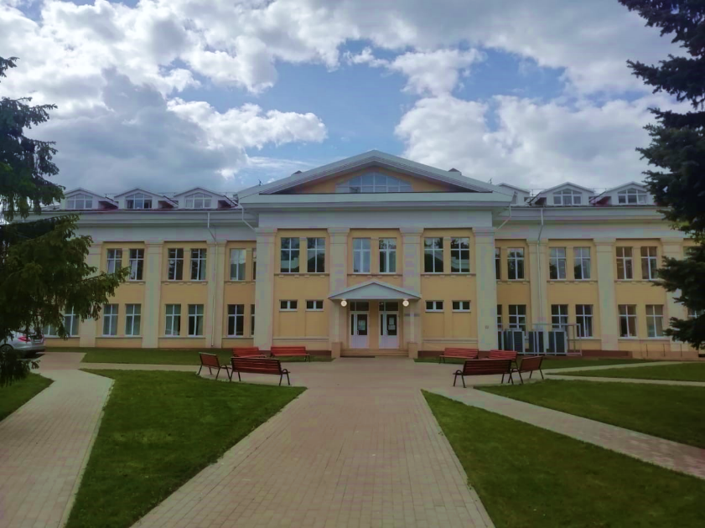
Welcome to «ICD ТМH» LLC!
Our engineering center is a young enterprise created on May 24, 2018.
The main resource of our organization is a highly qualified, high-performance team. We value our reputation and strive to be the best specialists in our field.
The company always keeps pace with the times, responding to trends in the development of the country's economy. Today we are implementing a number of projects, successfully introducing technologies.
The presence of our own test complex allows us to create unique products, perform experimental development of technical solutions, issue products in accordance with international standards.

Slide 3
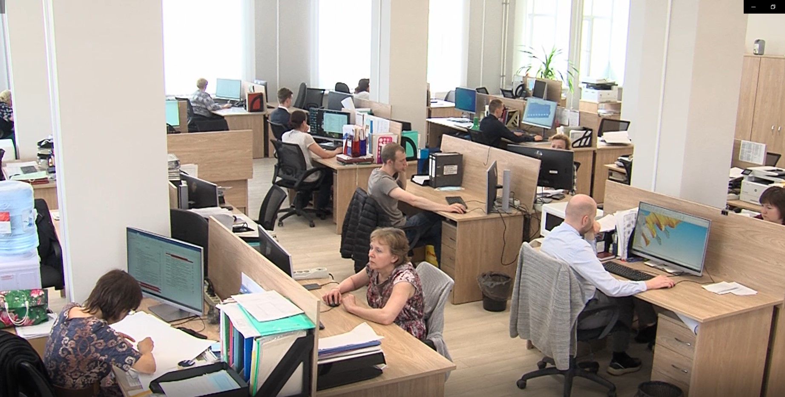
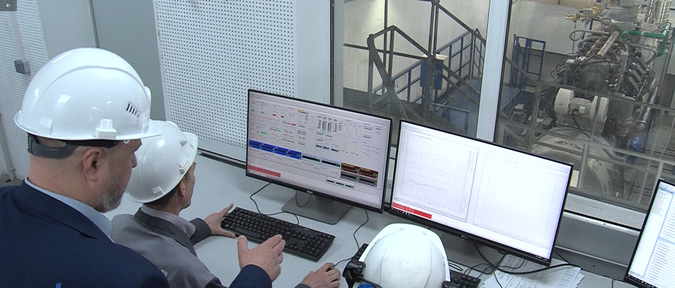

Engineering Center was founded in 2018.
In 2019 the company included a separate division "Penza"
Purposes of creation
Implementation of the Strategy and the unified technical policy of TMH
Offers expansion to consumers in terms of the diesel products range
Implementation in structures of the most demanding professional requirements of consumers in key markets such as railway, small energy, dump trucks
Improve competitiveness and ensure product compliance with the best global standards
Main areas of activity
Carrying out scientific researches
Scientific and technical development and engineering design in the field of engine building
Design support for mass-produced diesel engines for transport purposes and for small energy
Personnel resource:
"Kolomna" Division - 156 engineers
"Penza" Division - 22 engineers

Slide 4
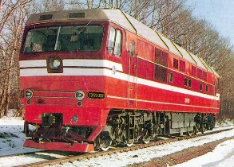
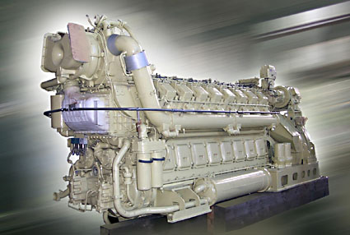
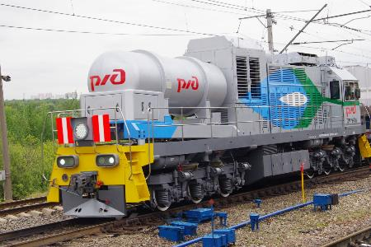

Design Activities
DIESEL&GAS ENGINES AND GENERATION SETS
:
DIESEL LOCOMOTIVES
GAS LOCOMOTIVES
FOR POWER PLANTS

Slide 5
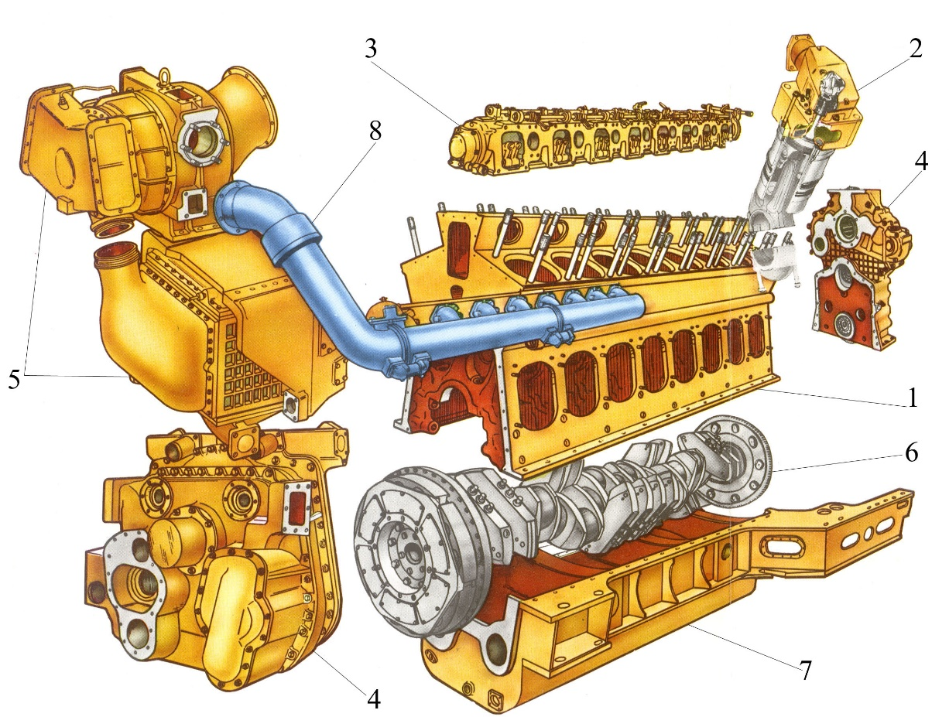
Engineering of diesel & gas engines for locomotives occupies the main scope of engineering work
BASIC PRINCIPLE OF DIESEL ENGINE LAYOUT
MODULAR DESIGN OF DIESEL MAIN BASE UNITS

Slide 6
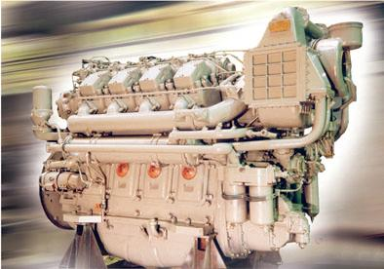
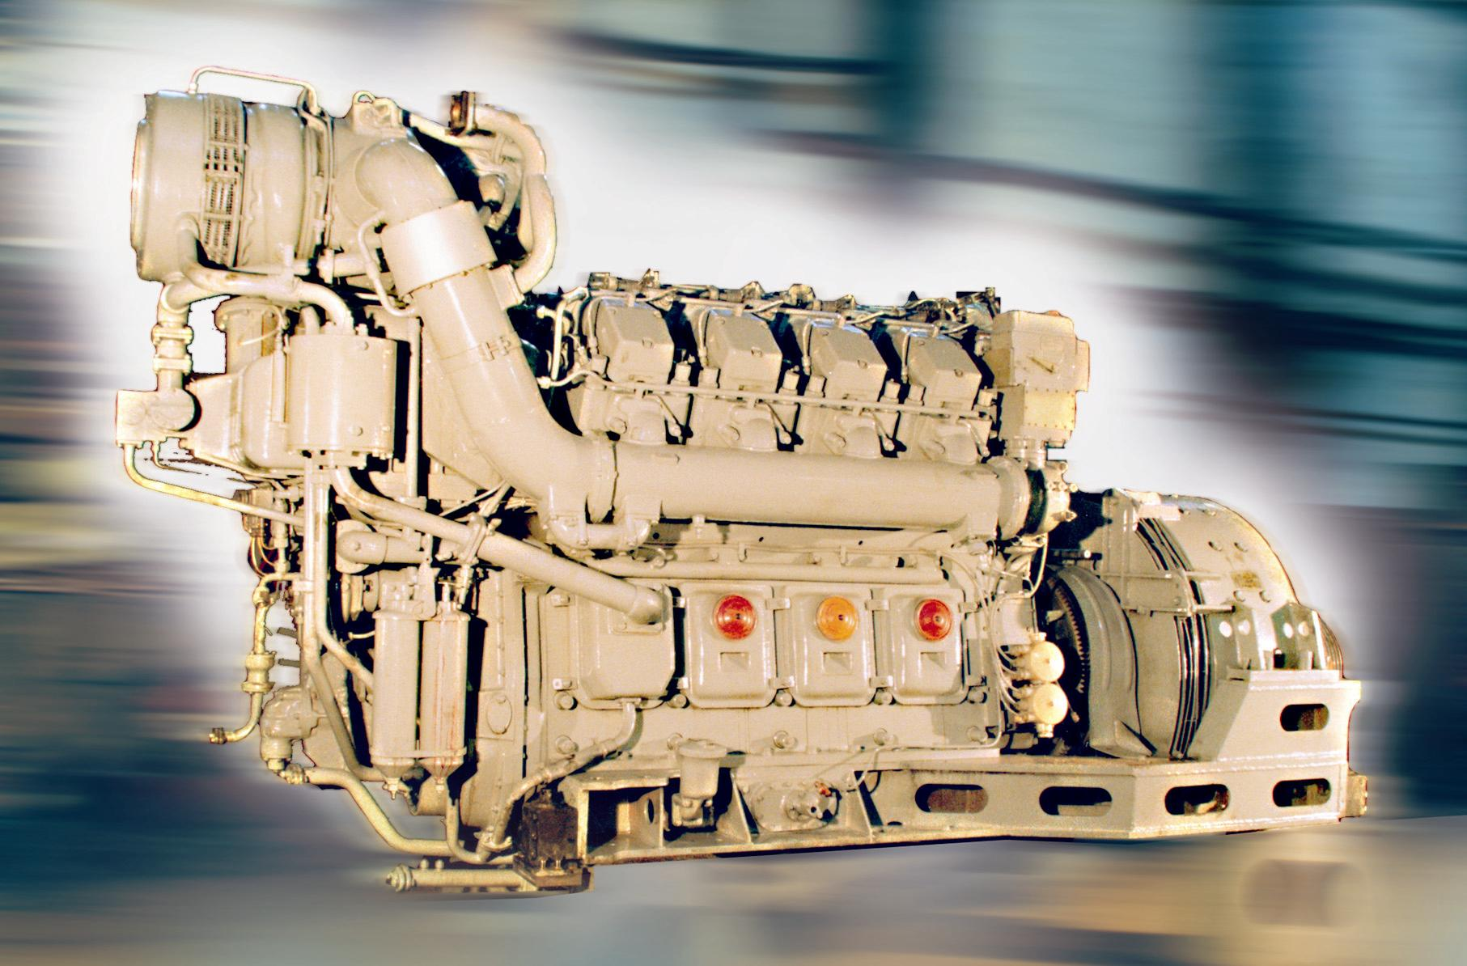
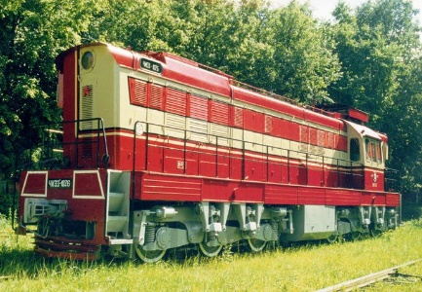
FOR MODERNIZATION OF DIESEL LOCOMOTIVES
DIESEL 8ChN 26/26
DIESELS 8ChN 26/26
V-SHAPED
4-36DG
7-6Д49
ЧМЭ3
ENGINEERING

Slide 7
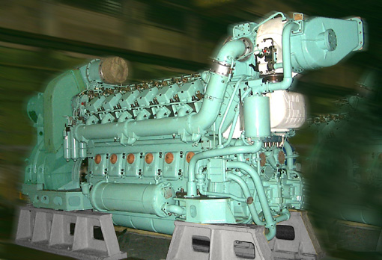
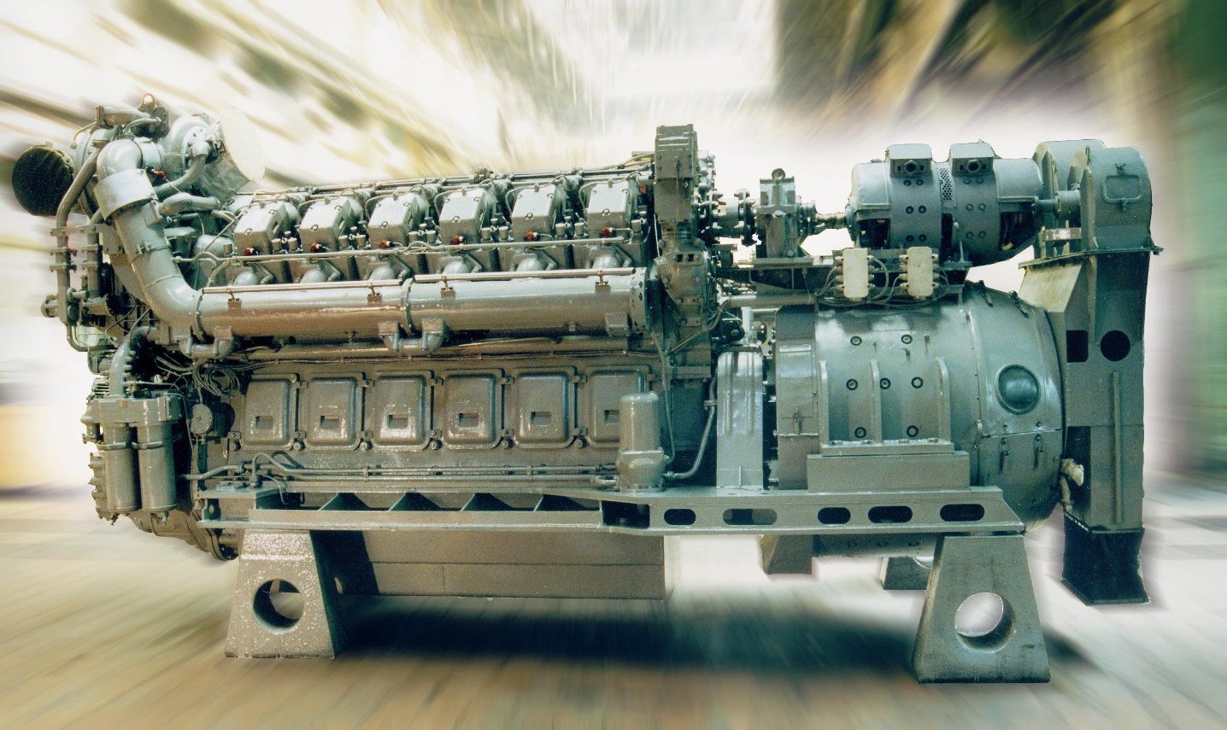
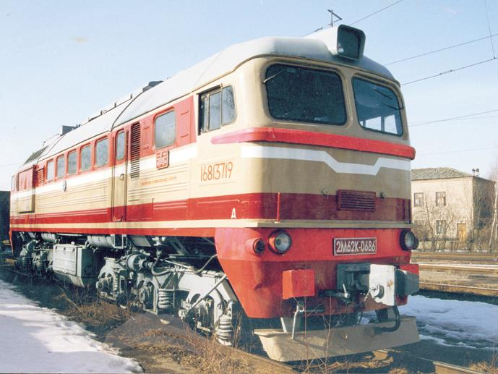
12D49M
5-26DG
FOR MODERNIZATION OF DIESEL LOCOMOTIVES
DIESEL GENERATOR 36DG-01 (8ChN26/26)
ENGINEERING
М62

Slide 8
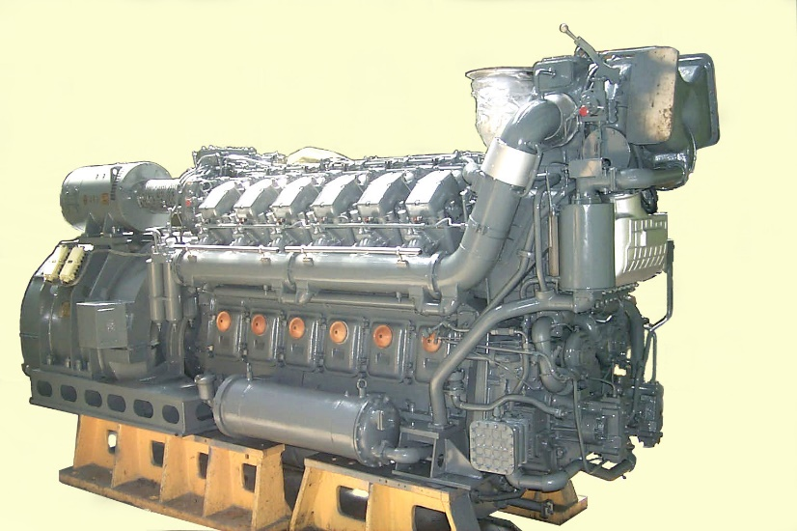
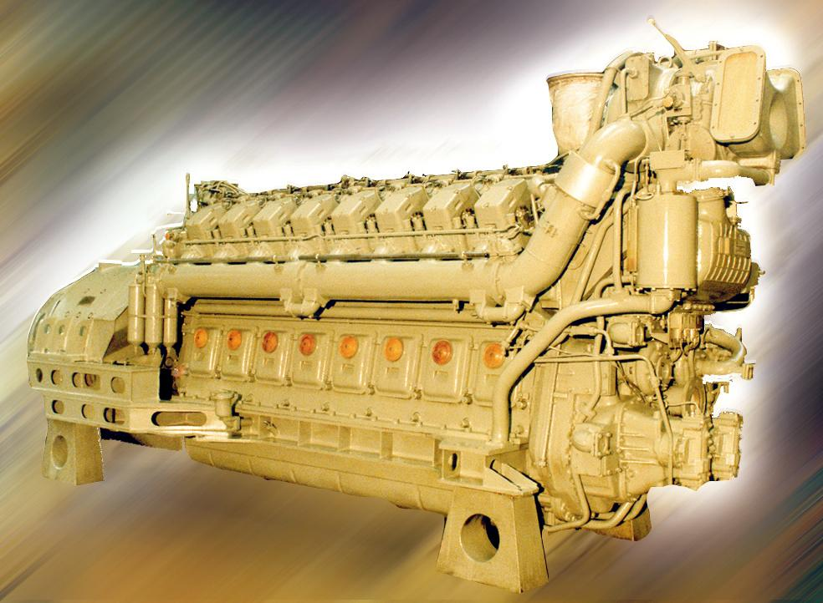
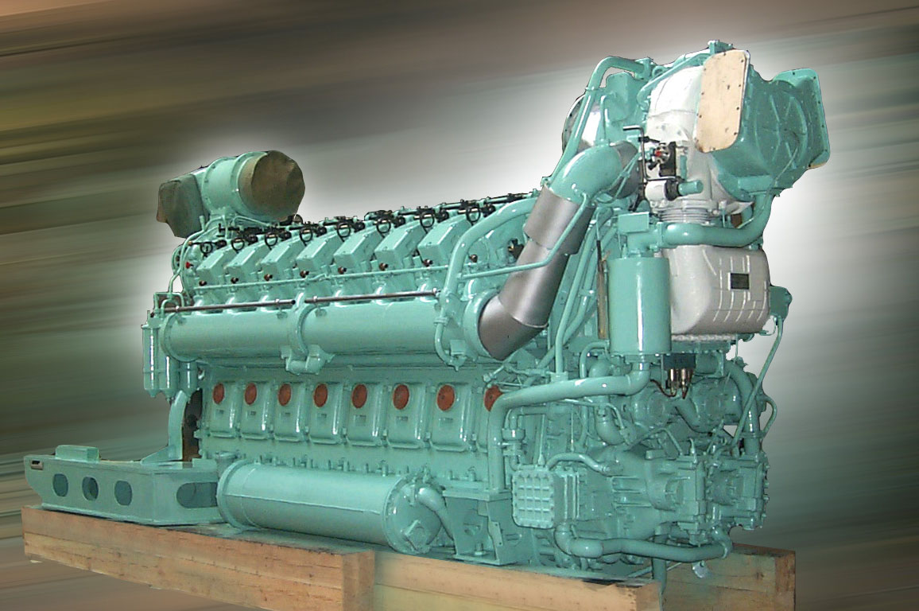
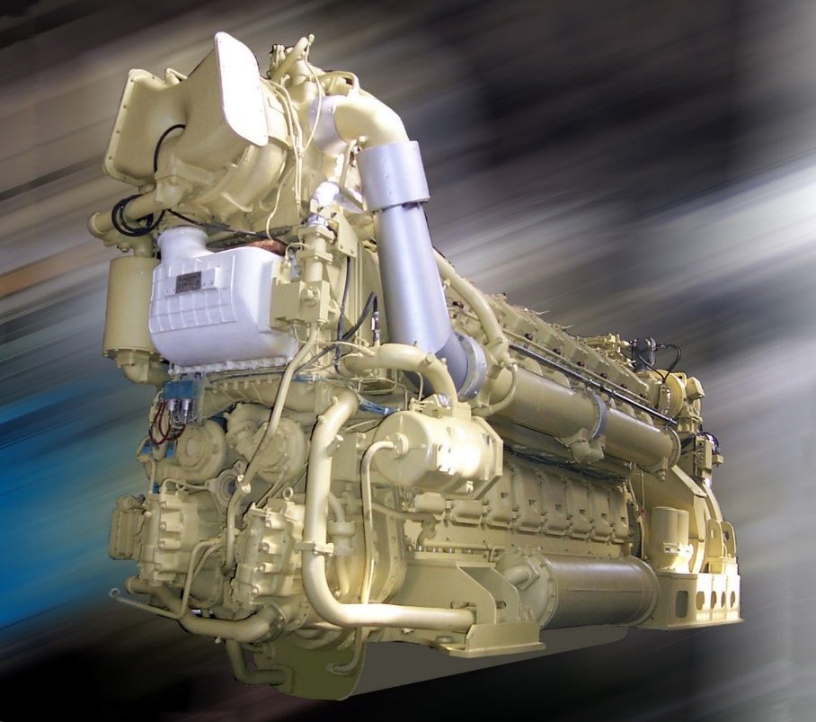
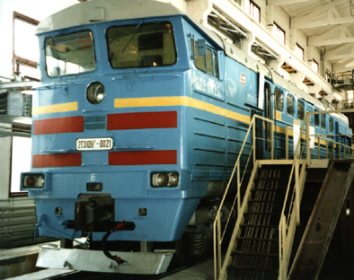
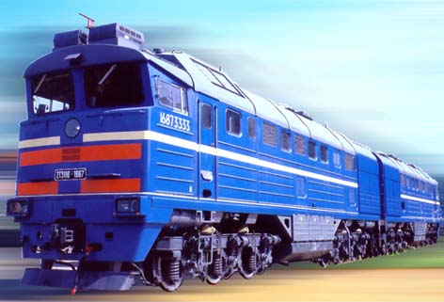
21-26DG
1А-9DG v.3
18-9DG
2А-9DG-02
FOR MODERNIZATION OF DIESEL LOCOMOTIVES
FOR MODERNIZATION OF DIESEL LOCOMOTIVES
DIESEL 16ChN 26/26
DIESEL 16ChN 26/26
2ТE10
2ТE116
ENGINEERING

Slide 9
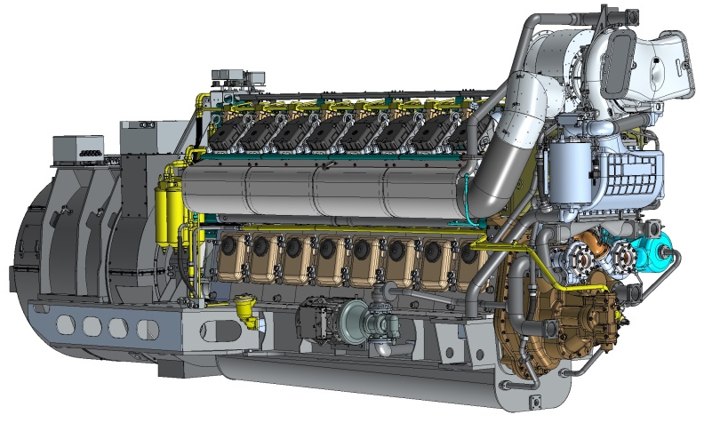
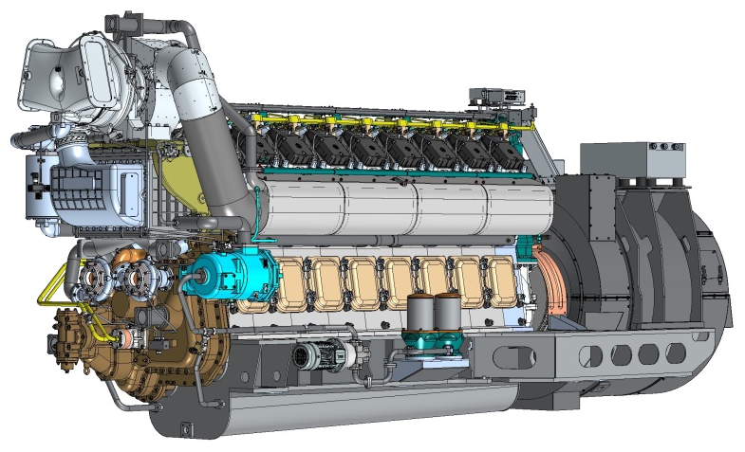
FOR NEW LOCOMOTIVES
Diesel Engine-generator 18-9DGM
Project Technical Concept
Deep modernization of diesel engines of type D49 (18-9DG)
The main task is to increase the reliability, consumer properties, technical level, ergonomics and easy of maintenance of diesel generators 18-9DG
Application
Freight line haul diesel locomotives 2(3)TE28
Main technical data and features
V-shaped, 16-cylinder, cylinder diameter x piston stroke = 260 x 260 mm
Rated/maximum power 2850-3100 kW at 1000 rpm
New traction unit, inverter start-up, integrated control and diagnostics system were used, auxiliary electric machines were excluded, camshaft drive was simplified

Slide 10
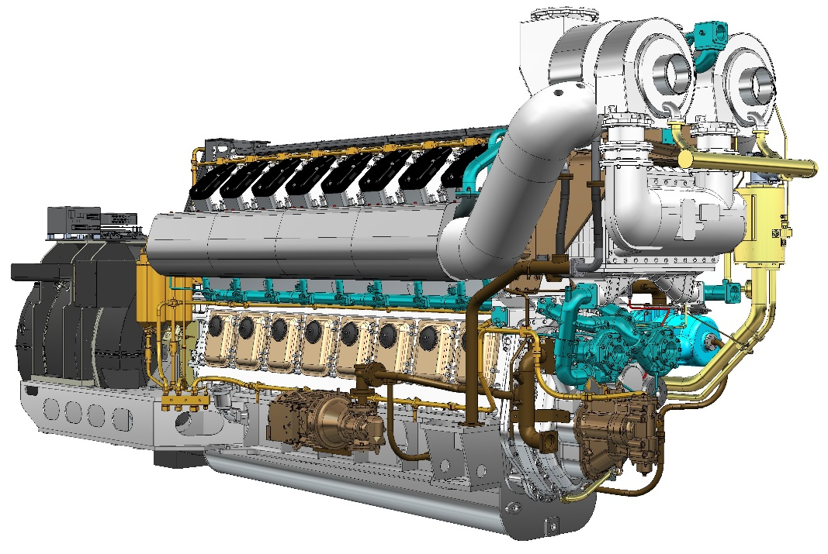
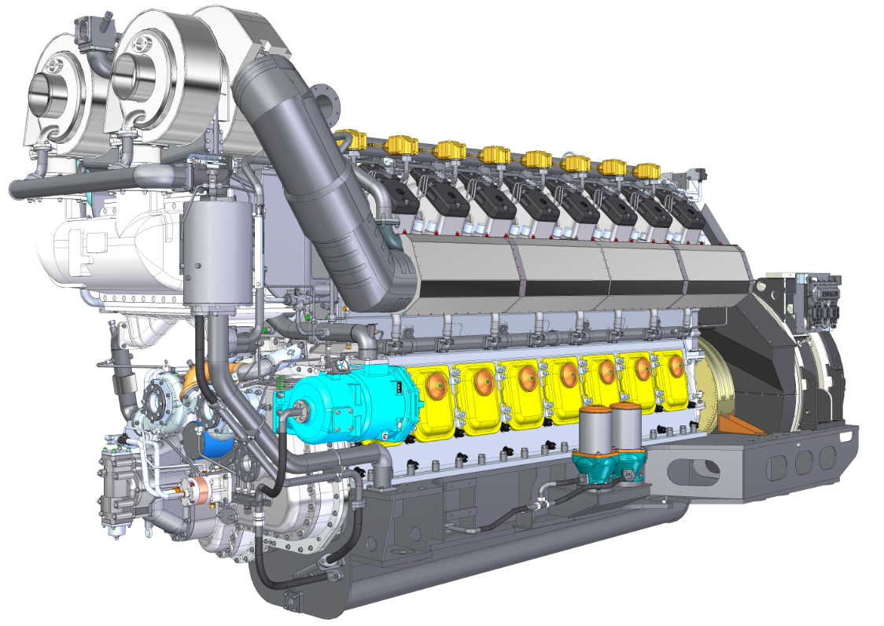
FOR NEW LOCOMOTIVES
Diesel Engine-generator 16LDG220
Project Technical Concept
The development of diesel engines D300 with the modernization of systems and units
Application
Prospective freight line haul locomotives 2TE30
Main technical data and features
V-shaped, 16-cylinder, cylinder diameter x piston stroke = 260 x 280 mm
Rated/maximum power 3300-3600 kW at 1000 rpm
New high-voltage traction generator, inverter start, complex control and diagnostics system

Slide 11
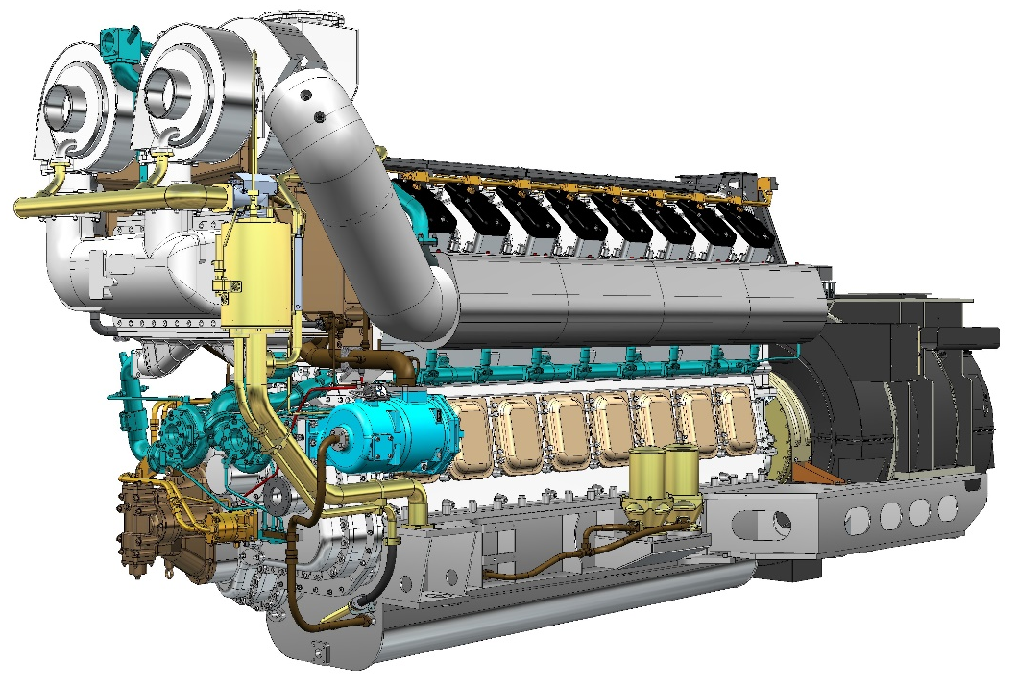
FOR NEW LOCOMOTIVES
Dual Fuel Engine-generator 16GDG
Project Technical Concept
Development of diesel engines D300 with alternative type of fuels
Technological and operational unification with 16LDG220
Scope
Prospective dual fuel freight line haul locomotives 3TE30AG
Main technical data and features
V-shaped, 16-cylinder, cylinder diameter x piston stroke = 260 x 280 mm
Rated/maximum power - 3300-3600 kW at 1000 rpm
Distributed Gas Supply to Cylinders
New high-voltage traction generator, inverter start, complex control and diagnostics system

Slide 12
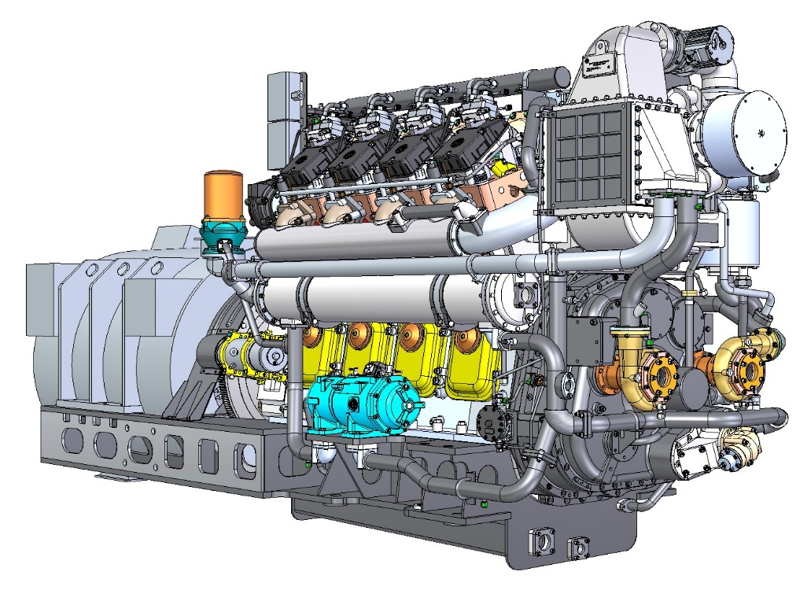
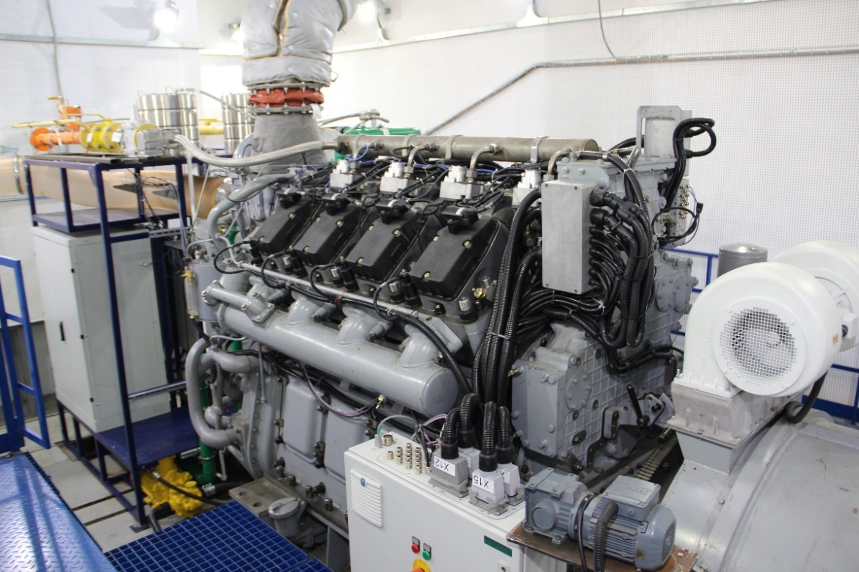
FOR NEW LOCOMOTIVES
Gas Engine-generator 9GMG
Project Technical Concept
Development of D49 type engines (8ChN26/26)
Provision of shunting locomotive with gas engine
High design unification with base engine
Application
Natural gas shunting locomotives TEM29 with AC-DC electric transmission
Main technical data and features
V-shaped, 8-cylinder, cylinder diameter x piston stroke = 260 x 260 mm
Rated power is 940 kW at 1000 rpm
Individual gas supply by cylinders, integrated engine control, protection and diagnostics system are implemented, self-ventilation traction unit, inverter start from traction unit is used
A special test bench for a gas engine has been created

Slide 13
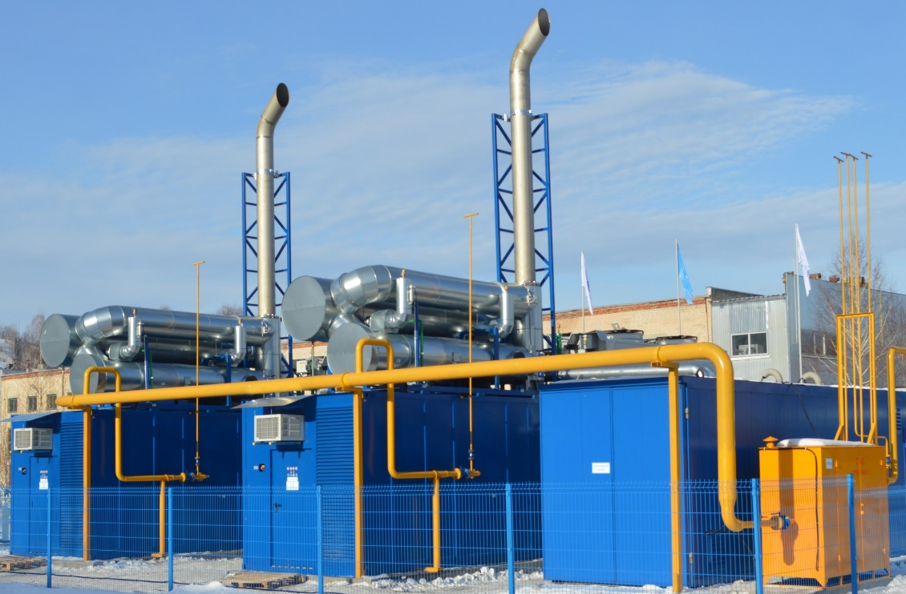
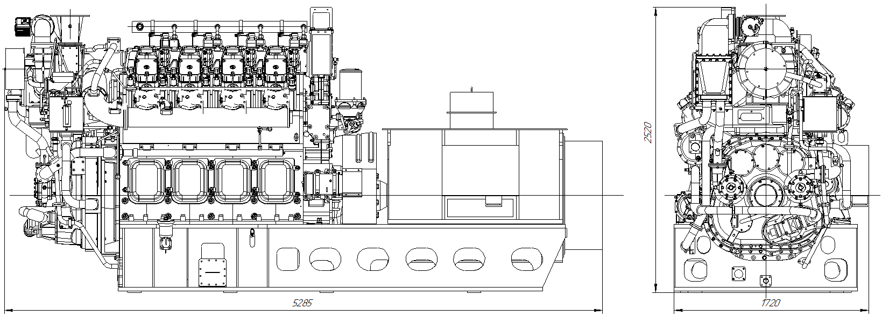
Power plant with gas engine-generator 1-9GMG
Project Technical Concept
The development of gas piston power plants with D49 type gas engines (8GChN26/26)
Demand generation for small power plants with gas engine generators
High design unification with base D49 type engine (8ChN26/26)
Scope
Power generation to provide small power facilities or for the internal network of the enterprise
Main technical data and features
Use of a gas piston engine-generator at a power plant 1-9GMG
Rated power at generator terminals is 900 kW
Ensuring the operation of the power plant in parallel with the enterprise network
Development prospects
Production of power plants based on 1-9GMG to provide electrical and thermal energy to TMH production sites and other consumers as part of import substitution.
Production of power plants based on high-speed engines, in-house production.

Slide 14
THANK YOU FOR THE ATTENTION!

